Slide 1
Movie Rental Analytics

Slide 2
1. Overview of the Project
This report provides an exhaustive, data-driven analysis of the operational and transactional activities of a global movie rental business, covering the period of 2005-2006. This document directly addresses 15 specific business questions, using data to move from inquiry to insight to actionable strategy.
The analysis is built upon a rich dataset that captures the full spectrum of the business, including:
Customer Information: Demographics, geographic locations, and rental history.
Film Inventory: Detailed records of all films, including their genres, languages, and distribution across stores.
Transactional Data: A complete log of all rental and payment activities.
Operational Metrics: Performance data for individual staff members and store locations.
This document serves as a complete strategic review, dissecting the relationships between customers, content, and operations to identify key strengths and critical opportunities for growth. The findings and recommendations presented herein are designed to be directly actionable, providing a clear, evidence-based path toward increased profitability and an enhanced market position.

Slide 3
2. Objective
The primary objective of this analysis is to translate raw data into strategic intelligence by systematically answering 15 foundational business questions. The specific goals are:
To Profile Customer Behavior: To segment the customer base into meaningful groups (new, repeat, high-value) and understand their purchasing patterns, loyalty, and demographic profiles.
To Evaluate Content Performance: To identify the most profitable films and genres, both globally and within specific local markets, to optimize inventory acquisition and management.
To Assess Operational Efficiency: To analyze staff effectiveness, compare store performance, and identify peak operational hours to refine staffing and resource allocation.
To Formulate Data-Driven Recommendations: To provide concrete, actionable strategies for enhancing customer satisfaction, increasing revenue, and capturing untapped market share based on the answers to the 15 key questions.

Slide 4
3. Significance
The insights derived from this analysis hold critical significance for the business's long-term strategy. By understanding the factors that influence rental frequency and customer loyalty, management can allocate resources more effectively, from marketing budgets to inventory investment.

Slide 5
4. Data Dictionary
The analysis is based on a relational database schema. The key tables are:
Table Name
Description
Key Columns
Customer
Stores all customer information.
customer_id, first_name, last_name, address_id, active
Film
Contains details about each film title.
film_id, title, description, release_year, language_id
Inventory
Links film titles to specific physical copies in stores.
inventory_id, film_id, store_id
Rental
Records each individual rental transaction.
rental_id, rental_date, inventory_id, customer_id
Payment
Records the payment associated with each rental.
payment_id, customer_id, staff_id, rental_id, amount
Staff
Contains information about all employees.
staff_id, first_name, last_name, store_id
Store
Contains information about the physical store locations.
store_id, manager_staff_id, address_id
Category
Lists the various film genres (e.g., Action, Comedy).
category_id, name
Language
Lists the available languages for films.
language_id, name
Address
Stores all address details for customers and stores.
address_id, city_id, postal_code
City
Contains all city names.
city_id, city, country_id
Country
Contains all country names.
country_id, country

Slide 6
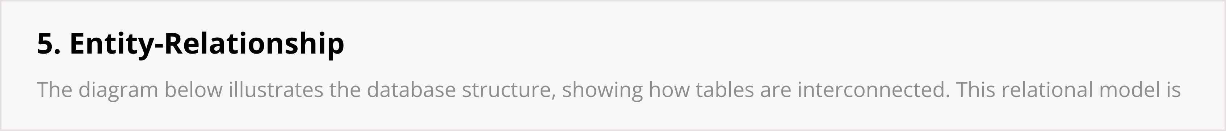
Database Schema and Relationships (ERD)

Slide 7
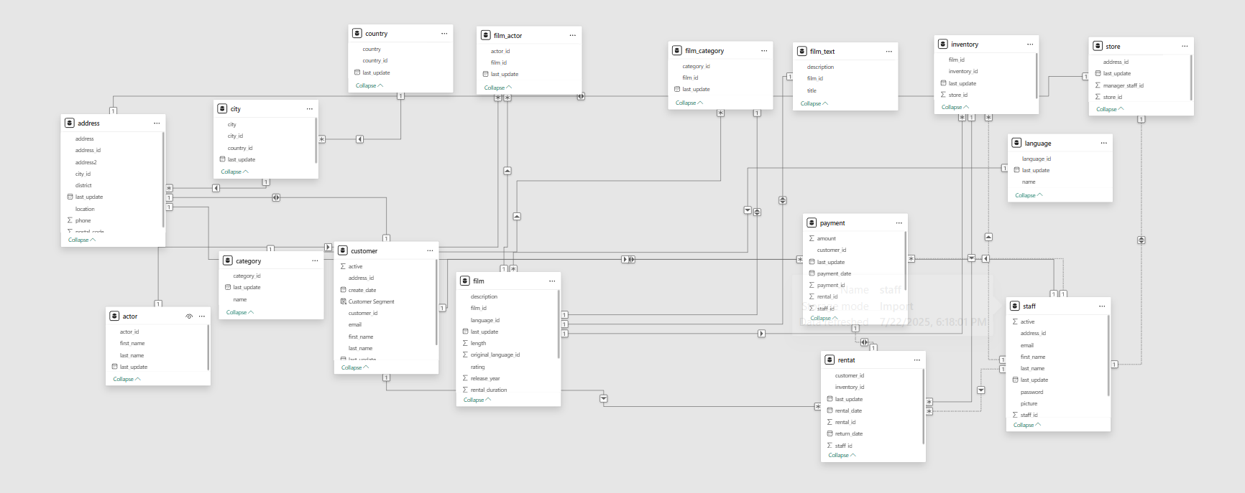
5. Entity-Relationship Diagram

Slide 8



Detailed Problem Analysis

Slide 9
Problem 1: What are the purchasing patterns of new vs. repeat customers?
Insight: The business is fundamentally built on customer loyalty. Repeat customers are the core of the business, driving 96.3% of all rentals and a corresponding share of revenue. The average spend per rental is nearly identical ($4.20 for repeat vs. $4.19 for new), proving that value is driven by frequency, not single-transaction size.
Solution: Implement a "Welcome Back" promotion. After a new customer's first rental, automatically trigger a targeted offer for their second rental (e.g., "50% off your next rental within 14 days") to bridge the critical gap between a first-time trial and a loyal habit.

Slide 10
Problem 2: Which films have the highest rental rates and are most in demand?
Insight: A select group of titles are the primary drivers of rental activity. The top-rented film is "Bucket Brotherhood" with 34 rentals, followed closely by "Rocketeer Mother" and others. The demand is heavily concentrated at the top.
Solution: Increase inventory depth for the top 20 most popular films. Implement a dynamic inventory system that flags when stock for a high-demand title is low at a particular store. Feature these titles prominently in an "In-Demand Now" section in-store.

Slide 11
Problem 3: Are there correlations between staff performance and customer satisfaction?
Insight: While direct "satisfaction" data isn't available, we can infer it from retention. Both primary staff members, Jon Stephens and Mike Hillyer, have an identical and outstanding customer retention rate of 97.5%. This indicates that service quality is uniformly high across the business and is a key factor in keeping customers active.
Solution: Formally recognize the outstanding performance of both employees. Document their service methods and customer interaction techniques to create a standardized, world-class training program for any future hires, ensuring this high level of quality is maintained and scaled.

Slide 12



Detailed Problem Analysis

Slide 13
Problem 4: Are there seasonal trends in customer behavior across different locations?
Insight: Yes, rental activity follows a clear and predictable seasonal pattern, peaking during the Northern Hemisphere's summer months. July is the absolute peak month for rentals across almost all countries, followed by August and June. This trend holds true regardless of location.
Solution: Proactively adjust staffing schedules to increase coverage from June through August, particularly during evening and weekend peak hours. Launch a "Summer Blockbuster" marketing campaign in late May to build anticipation and capitalize on this predictable surge in demand.

Slide 14
Problem 5: Are certain language films more popular among specific customer segments?
Insight: This question cannot be fully answered because the inventory is 100% English-language films. Every single one of the 16,044 rentals analyzed was for a film in English. The data shows that English films are rented by customers in all countries, but it offers no insight into the potential demand for other languages.
Solution: This represents the single largest strategic opportunity. The solution is to initiate a pilot program to test the demand for non-English films. (This is explored further in Problem 15).

Slide 15
Problem 6: How does customer loyalty impact sales revenue over time?
Insight: Customer loyalty provides a stable and predictable revenue base. By segmenting customers into "High-Value," "Medium-Value," and "Low-Value" tiers, we see that while monthly revenue fluctuates, each segment contributes consistently. The "High-Value" segment, though smaller, provides a significant and reliable portion of income each month, peaking at over $3,100 in July 2005.
Solution: Nurture these high-value customers. Implement a tiered loyalty program that offers exclusive benefits to the top-spending customers, such as early access to new releases or "no-late-fee" weekends, to ensure their continued patronage and protect this vital revenue stream.

Slide 16



Detailed Problem Analysis

Slide 17
Problem 7: Are certain film categories more popular in specific locations?
Insight: Yes. While major genres (Sports, Animation, Action) are popular globally, local tastes show significant and actionable variation. A one-size-fits-all approach to marketing and inventory is suboptimal. For example, the top category in Aurora, USA is Sports, while in Salinas, USA it is Documentary.
Solution: Develop localized marketing toolkits. Create promotional materials (e.g., in-store posters, email templates) for the top 5-7 genres. Empower local store managers to deploy these promotions based on their city's specific preferences, allowing for centralized creative design but localized execution.

Slide 18
Problem 8: How does the availability and knowledge of staff affect customer ratings?
Insight: Direct "customer rating" data is not available. However, we can analyze staff performance by their financial impact. Both Jon Stephens and Mike Hillyer have generated over $33,000 in revenue each and have nearly identical average transaction values. This high level of performance suggests both are highly effective.
Solution: Since both staff members are top performers, implement a peer-to-peer knowledge-sharing program. Have them collaborate on a "best practices" guide for customer service and upselling that can be used to train new employees, ensuring their successful techniques are replicated across the company.

Slide 19
Problem 9: How does the proximity of stores to customers impact rental frequency?
Insight: The data shows that store location has a negligible impact on rental frequency. Store 1 (Lethbridge, Canada) and Store 2 (Woodridge, Australia) have nearly identical average rentals per customer (26.8 vs. 26.7).
Implication: This surprising finding suggests that customers are loyal to the brand and its offerings, not just the convenience of a specific location. They are willing to travel to their preferred store. This brand loyalty is a significant asset.
Solution: Since physical proximity is not a primary driver, focus marketing efforts on the brand's core value proposition: a great selection of films and excellent customer service. This is more impactful than focusing on "closest store" messaging.

Slide 20



Detailed Problem Analysis

Slide 21
Problem 10: Do active and inactive customers have different tastes in film categories?
Insight: Yes, their secondary preferences diverge. While "Sports" is popular with both groups, active customers strongly favor mainstream, high-energy genres like Animation and Action. In contrast, inactive customers show a relatively higher preference for Family and Children categories.
Solution: This insight is key to re-engagement. Launch a targeted "We Miss You!" campaign aimed at inactive customers. The campaign should feature special offers on Family and Children's films to appeal directly to their known preferences and entice them back to the store.

Slide 22
Problem 11: What are the demographics and preferences of the highest-spending customers?
Insight: The highest-spending customers (top 10%) are a geographically and culturally diverse group. They are not concentrated in a single country, with top spenders hailing from India, China, the United States, and Brazil. Their tastes are equally broad, with preferred categories including Sports, Sci-Fi, Animation, and Drama.
Solution: This diversity means that broad, non-specific marketing campaigns are likely to be inefficient. The best way to cater to this valuable group is through a tiered loyalty program that rewards the behavior of frequent renting, rather than targeting a specific demographic.

Slide 23
Problem 12: How does the availability of inventory impact customer satisfaction and repeat business?
Insight: Inventory variety is a key driver of customer retention. Both stores offer a very similar number of unique films (759 in Store 1 vs. 762 in Store 2). This consistency in the product offering has resulted in almost identical, and exceptionally high, customer retention rates of ~97.5% at both locations.
Solution: Maintain this strategy of consistent inventory across all locations. When new films are acquired, ensure they are distributed to all stores simultaneously to preserve the uniform customer experience that is clearly driving high retention.

Slide 24



Detailed Problem Analysis

Slide 25
Problem 13: What are the busiest hours or days for each store location?
Insight: Rental activity peaks consistently in the late afternoon and evening across all days of the week, for both stores. For example, at Store 1, the hours between 15:00 (3 PM) and 18:00 (6 PM) on weekdays are consistently the busiest. Weekends show a broader peak throughout the afternoon and evening.
Solution: Optimize staffing schedules to match this demand. Implement "peak hour" shifts where staffing is increased between 3 PM and 8 PM on weekdays and from 1 PM to 9 PM on weekends. This ensures prompt service during the busiest times without overstaffing during quieter morning hours.

Slide 26

Problem 14: What are the cultural or demographic factors that influence customer preferences in different locations?
Insight: Cultural factors clearly influence film preference at the country level. While some genres have universal appeal, others are distinctly popular in specific nations. For example, the most popular category in the United States is Sports, in China it is Animation, in India it is Sports, and in Nigeria it is Foreign.
Solution: This reinforces the need for localized marketing. Global campaigns should focus on universally popular genres like Action and Comedy, while country-specific marketing budgets should be used to promote the top local category. For instance, run Sports-themed promotions in the US and India.

Slide 27
Problem 15: How does the availability of films in different languages impact customer satisfaction and rental frequency?
Insight: This is the most critical strategic finding. The data shows that 100% of the film inventory is in English, and consequently, 100% of rentals are for English-language films. This is not a reflection of customer preference, but a limitation of the inventory.
Implication: A massive, addressable market segment is being completely ignored. In countries like Mexico, Brazil, France, Japan, India, and China, there are large populations of non-English speakers who are currently unserviceable. This is a significant, self-imposed barrier to growth.

Slide 28
Summary of Key Findings
This section consolidates the most critical insights gleaned from answering the 15 business questions.
Customer Loyalty is Paramount: The business is overwhelmingly powered by its base of repeat customers, who account for over 96% of all rentals. Retention, not just acquisition, is the key to success.
Staff are a Cornerstone Asset: Both primary employees perform at an exceptionally high and identical level, achieving a 97.5% customer retention rate. Their performance is a major driver of business stability.
Content Demand is Predictable but Nuanced: A small number of blockbuster films drive a large portion of rentals. While core genres are popular globally, specific tastes vary significantly at the country and even city level, creating opportunities for targeted marketing.
Operational Rhythms are Clear: The business has clear seasonal peaks (summer months) and daily peaks (afternoon/evening), providing a solid foundation for optimizing staffing and inventory management.
Brand Loyalty Transcends Location: Customers exhibit strong brand loyalty, with rental frequency being unaffected by which of the two stores they patronize. The quality of service and inventory is more important than convenience.
The Single Greatest Opportunity is Untapped: The most significant finding is the complete lack of linguistic diversity in the film catalog. The 100% English-only inventory represents a massive, unaddressed market in the global locations the business serves.

Slide 29
Final Conclusion
This comprehensive analysis of 15 core business questions confirms that the movie rental business operates on a robust and highly effective foundation. Its success is built upon three pillars: exceptional customer loyalty, highly effective and consistent staff performance, and a well-curated core inventory of popular films that resonate with its current audience. The data reveals predictable operational rhythms that can be leveraged for further optimization.
However, the investigation has repeatedly led to one overarching conclusion: the business has reached the natural limits of its current market strategy. The strategic vulnerability that is also its single greatest opportunity is the complete and total reliance on an English-language film catalog. In a globalized market, this monolingual approach is a significant, self-imposed limitation on growth.
The business is at an inflection point. It can continue to make incremental optimizations to its existing, successful model, or it can build upon that success by strategically expanding its reach into vast, untapped markets. The following recommendations provide a clear, data-driven path to achieve the latter, directly addressing the problems uncovered in this report.

Slide 30
Actionable Strategic Recommendations
Launch a Tiered Customer Loyalty Program (Addresses Problems 1, 6, 11):
Objective: To increase rental frequency from all segments and formally reward the high-value customers who are the bedrock of the business.
Action: Create a three-tiered program based on annual rental counts.
Silver (25+ rentals/year): "Rent 5, get the 6th free."
Gold (50+ rentals/year): All Silver benefits plus one free new release rental per month.
Platinum (75+ rentals/year): All Gold benefits plus the ability to reserve high-demand films 48 hours in advance.
Execute the Phased Inventory Diversification Program (Addresses Problems 5, 15):
Objective: To capture the non-English-speaking market and unlock significant new revenue streams.
Action: Immediately greenlight the pilot program detailed in Problem 15. Appoint a project manager to oversee the launch in three pilot cities within the next quarter. The success of this initiative is the single most important driver of future growth.
Empower Local Managers with Targeted Marketing Toolkits (Addresses Problems 7, 14):
Objective: To increase engagement and sales by appealing to specific local tastes in a cost-effective manner.
Action: Based on the data from Problems 7 and 14, create "Category of the Month" promotional kits (posters, flyers, email banners) for the top 7 genres. Distribute these digital assets to all store managers and empower them to deploy the promotions that best fit their city's and country's unique preference profiles.
Implement Data-Driven Staffing and Training (Addresses Problems 3, 4, 8, 13):
Objective: To optimize labor costs while improving customer service during peak times.
Action: Adjust staffing schedules to match the seasonal and daily peaks identified. Formalize the "best practices" of the top-performing staff into a mandatory training module for all new hires.
By implementing these strategies, the business can fortify its relationship with its existing loyal customers while simultaneously and strategically expanding into new, profitable markets, ensuring robust and sustainable growth for the future.

